Slide 1
Children Monitoring System An iOS Application

Slide 2







Unnathi VallapuReddy
(s528768)
Veera Kishon Kumar Mucherla (s528751)
Prathibha Kamani
(s528804)
Koushik Lakkaraju
(s528745)
Alekhya Devi Manne
(s528808)
Karthik Laddipeerla
(s528805)
Reshma Shaik
(s528761)

Slide 3
Contents
Introduction
Functionalities implemented
Design
Problems faced
Demo
Summary

Slide 4
Introduction
Children Monitoring System(CMS) is an application, which finds its use in tracking the location of the child.
CMS allows parents to check the monitoring records of their children besides tracking them in real time
CMS is being developed in iOS (Swift) operating system
CMS is compatible on all iOS mobiles and Mac PC’s

Slide 5
Functionalities Implemented
User login
New user Sign-Up
Forgot Password
Adding Child
Settings

Slide 6
Functionalities implemented(Cont.)
Tracking child’s location
Alert Settings page
Time resolution settings
Record management
Deleting Child
User profile

Slide 7
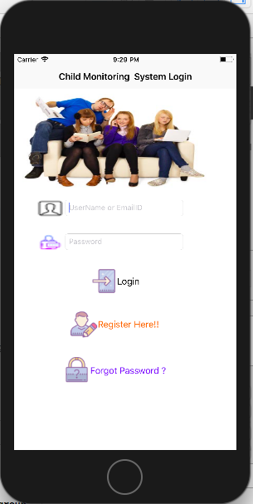
Design
Image shows the login page of the app, which also has the register and forgot password options.

Slide 8
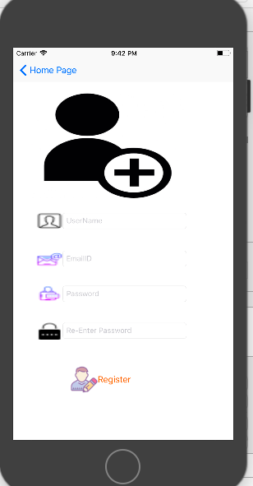
Design(Cont.)
Image shows the user registration page.

Slide 9
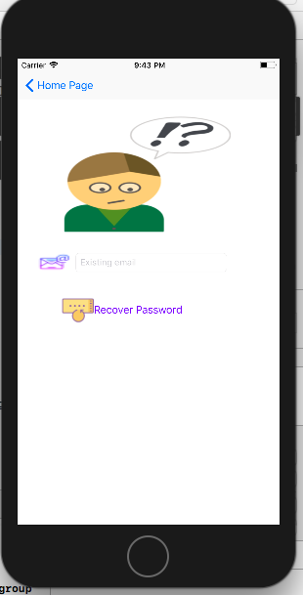
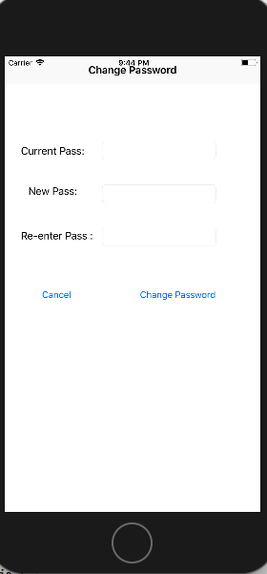
Design(Cont.)
Image on the left shows the forgot password page which has the option for password recovery through email.
Image on the right shows the change password page.

Slide 10
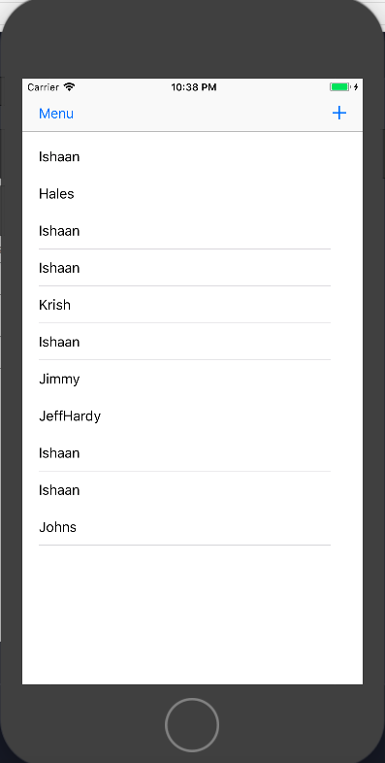
Design
Image shows the list of children names who were already added.
We can add the children clicking the “+” symbol on the top right corner of the screen
Fig:1 Home page

Slide 11
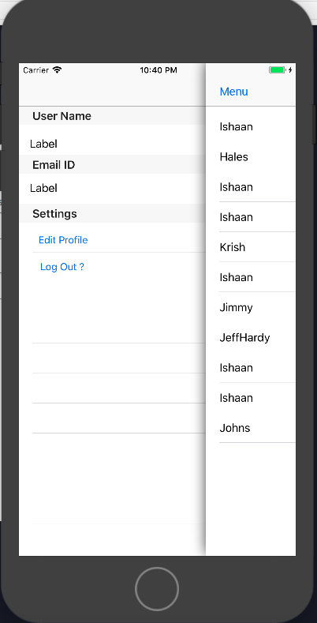
Design (contd.)
This image shows the settings available to the users on the clicking the “Menu” on the top
Fig:2 Settings page

Slide 12
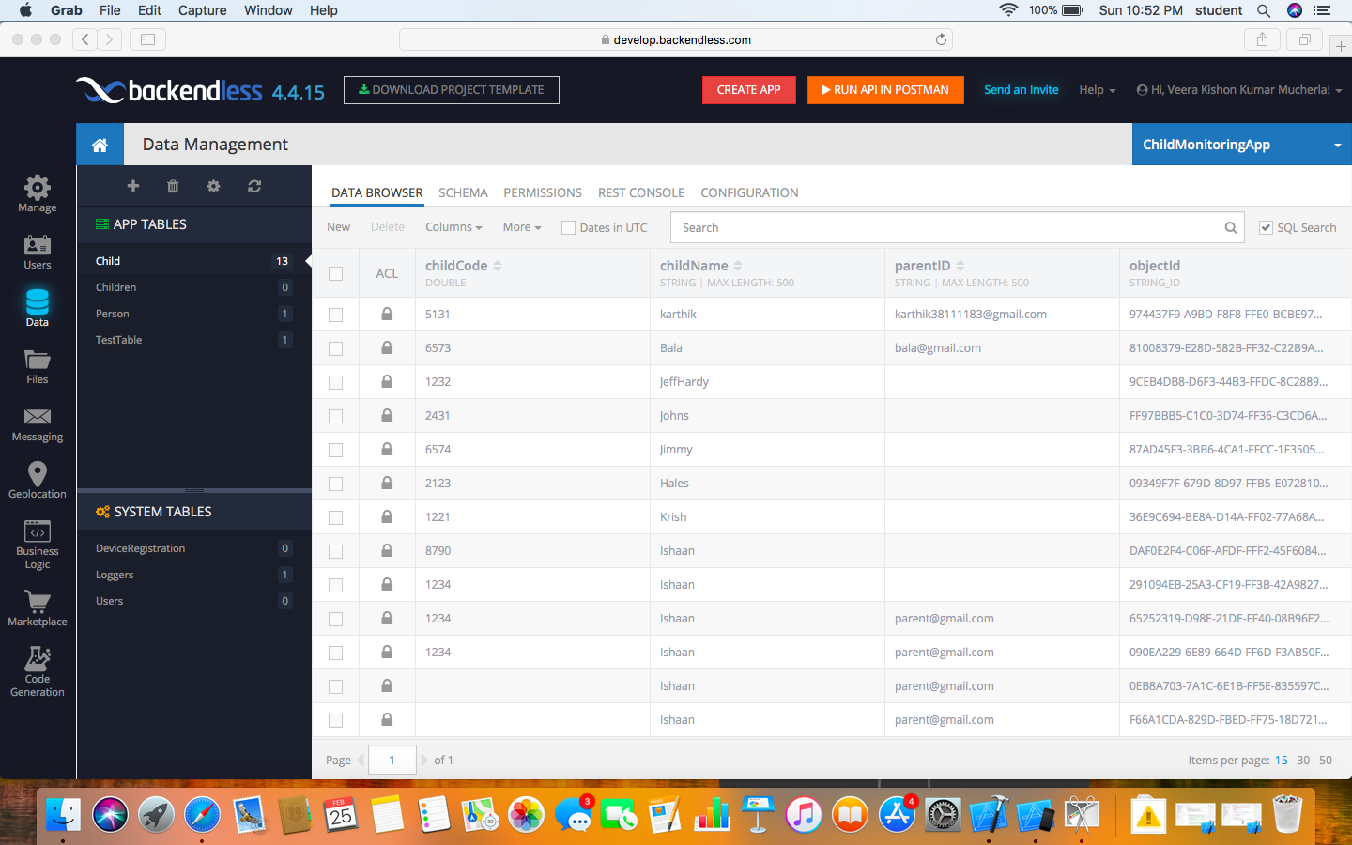
Design (contd.)
Fig:3 Backendless page

Slide 13
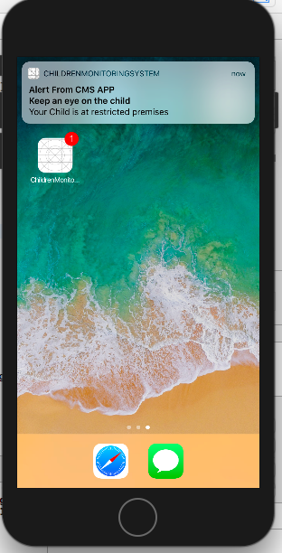
Popup Alert Functionality
Image shows the pop-up alert message.

Slide 14
Problems faced
Integration of objective-C files was found difficult in our project
Establishing the relations in the backendless was also quite problematic

Slide 15


Slide 16
Summary
This application is best used to track the location of a child.
The motive of the application is to ensure safety of the child.
The application seems to be more user friendly and convenient to the users with more number of options and functionalities implemented.

Slide 17


